Slide 1


WEATHER BRIEFING AND FLIGHT PLANNING GUIDE
SHREENITHI S (CB.EN.U4CSE21257)
yash puthalath (cb.en.u4cse21270)

Slide 2





What is Hybrid Data Structures?
Hybrid data structures combine the benefits of individual data structures and forms a multiple data structure.

Slide 3
Why Hybrid Data Structures?
Optimize complex problems
Handling large datasets
Efficient storage
Improved performance
Reduced usage of time and resources

Slide 4


What did we do?
Simple GUI weather forecasting application using OpenWeatherMap API and Flight Status Tracking using Aviation Tree API
Help users make informed decisions about how prepare for the weather and avoid any discomfort
Helps users to track the status of their flight by giving in the Flight Number,
to know the flight status.

Slide 5
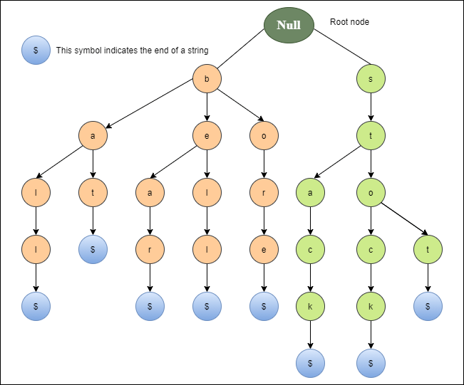
Why Trie is used?

Slide 6

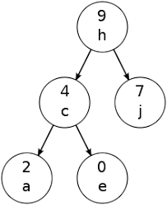
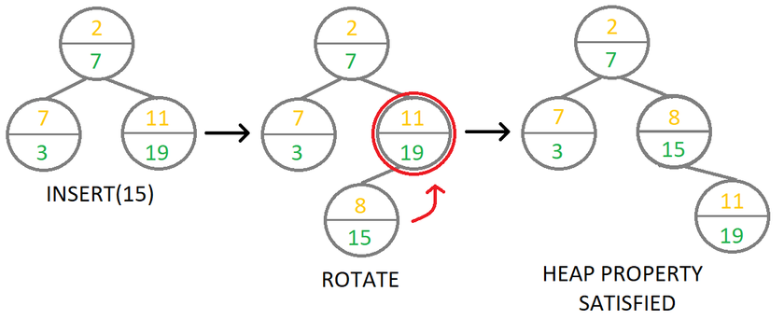
Why Treap is used?
Treap = Binary Search Tree + Heap
Node = Key + Priority
The keys satisfy the BST property
The priorities satisfy the heap property
Maintain balance in the face of random insertions and deletions

Slide 7


Implementation Details
Input Location : Output Information
Integrate Treap(Weather Forecast) + Hash Maps(Flight Details)
Added tkinter GUI

Slide 8

Design and Trade-offs
Treap is well-suited for applications where dynamic updates are frequent.
Treap can improve the efficiency of priority-based access
Trade-offs
Increase memory usage.
Increasing computational cost of updates.

Slide 9


Design and Trade-offs
Lookups: Frequently look up values based on a key, a hash map can provide fast access.
Symbol tables: Store information about variables, functions, and other symbols in a program
Trade-offs
Space usage: Use a lot of memory, especially if the hash table is not well-sized.
Hash function quality: A poor hash function can result in many collisions.
Key uniqueness: require keys to be unique.

Slide 10





Practical Application Treap
Real-time Stock trading - Price and priority of stock.
Network Routing - Route message through destination and priority.
Web caching - Prioritize web pages on access frequency.
Task scheduling - schedule tasks on basis of deadline urgency.

Slide 11
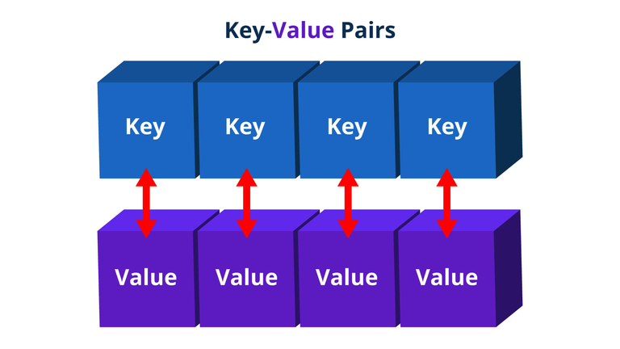
Practical Application Hash Maps
Databases: Quickly look up records based on a key value, such as a customer ID or product code.
Caching: Quickly retrieve frequently accessed data from memory.
Compiler symbol tables: Store information about variables, functions, and other symbols in a program.
Web applications: Store session data, user preferences, and information that needs to be quickly accessed.

Slide 12

Limitations, Challenges
Randomness of Priorities ---> Unbalanced, decreased efficiency
Memory Usage ---> Increased due to Key + Priority Value
Complex implementation and tradeoff between priority based access and memory usage.
Improvements
Improved balancing algorithms: New algorithms to better balance priorities that are not truly random.
Hybrid data structures: Combine the properties of the Treap data structure with other data structures.

Slide 13


Performance Analysis
Treap
The Time Complexity - O(Log n)
The Space Complexity - O(n).
Hash Map
The Time Complexity - O(1)
The Space Complexity - O(n).

Slide 14

Hash Maps for Storing Flight Details
The Hash Map uses the Key Value Pair to Store Fight Details where the Key Is the Flight Number and the Values Include all the Important Details of the Flight Like-
Departure and Destination Airports
Flight Status
Departure and Arrival Time
Name of the Airline
IATA Number -International Air Transport Association

Slide 15
Why Hash Maps?
Best Efficiency, Simplicity, Performance and Flexibilty is achieved by Hash maps.
The Implementation of This Data Structure is Fairly Easy and just uses Python Dictionaries for the Entire Application.
It has a time Complexity of O(1) which makes retriving Flight Details Quick and Easy.

Slide 16
Conclusion
The Project is to implement Hybrid Data Structure to Create a Weather Forecast System and a Flight Tracking System using Treap and Hash Maps.
The project demonstrated the practicality and effectiveness treap for efficiently storing and accessing data based on both sorted order and priority-based access.
And uses Hashmap to store the key value pair and retrieve the flight details accordingly.
Both integrated successfully using Python.

Slide 17





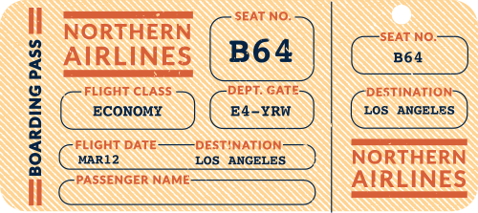
WEATHER FORECAST
JUN 10, 2023
10%
20%
Chance for
some flashes
of lightning.
70%
Chance of
a gloomy
rainy Day!
Chance of
a beautiful sunny Day!
THANK YOU!
-5C
3:30pm
25C
It may drizzle
a little in the afternoon.
It will drop
later at night
to freezing.
It is currently
pretty warm
right now.

